Slide 1
BLOOD BANK MANAGEMENT SYSTEM

Slide 2
ABSTRACT
In today’s world, people often come across situations where they need blood or blood plasma.
In such emergency conditions blood donor or plasma donor details becomes really handy.
The user can find the details of Donor’s either on Blood group basis, or City basis or on the basis of the donors Id.
The file stores name, age, phone number, address and blood group of the Donor’s.
New donors can also register.
It will also display the amount to be paid to the donor.

Slide 3
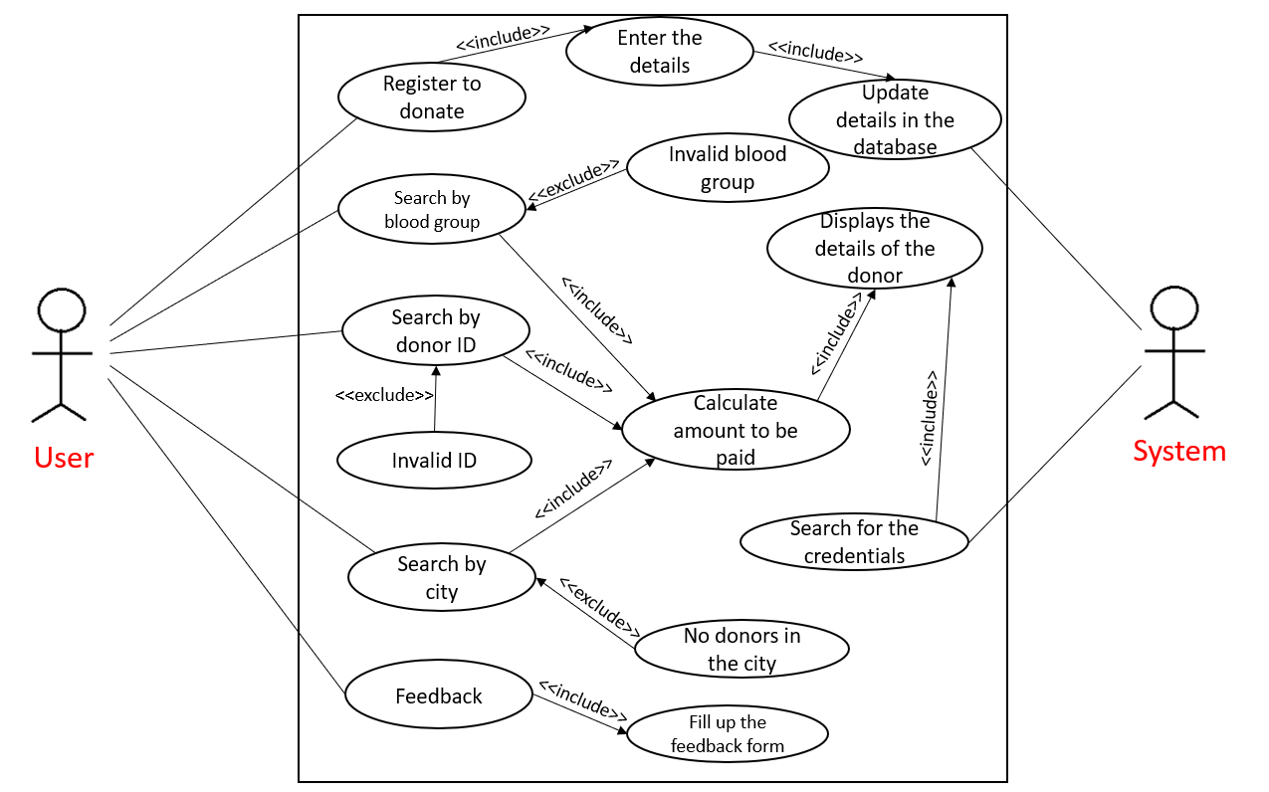
USE CASE DIAGRAM

Slide 4
TECHNOLOGY USED:
All computer software needs certain hardware components or other software resources to be present, in order for computers to be used efficiently. These prerequisites are known as System Requirements. Within this, we have two types – Software Requirements and Hardware Requirements.
SOFTWARE REQUIREMENTS
Software Requirements deal with defining the software resource requirements and prerequisites that need to be installed on a computer to provide optimal functioning of an application. These preconditions are generally not included in the software installation package and need to be installed separately. In order to use “BLOOD BANK MANAGEMENT SYSTEM”, one should have the following:
• Operating System: Windows 7 and above
• C Compiler: GNU Compiler Collection (GCC)
• Editor: Any text editor (preferably Visual Studio Code)
HARDWARE REQUIREMENTS
Hardware requirements refer to the common set requirements defined by any operating system or software application and are usually the physical computer resources. In this, we look into the architecture, processing power, memory, secondary memory, display adapter and peripherals.
In order to use “BLOOD BANK MANAGEMENT SYSTEM”, one should have the following:
• Processor: Ryzen 5 / Intel i5 and above
• Memory: 8 GB RAM

Slide 5
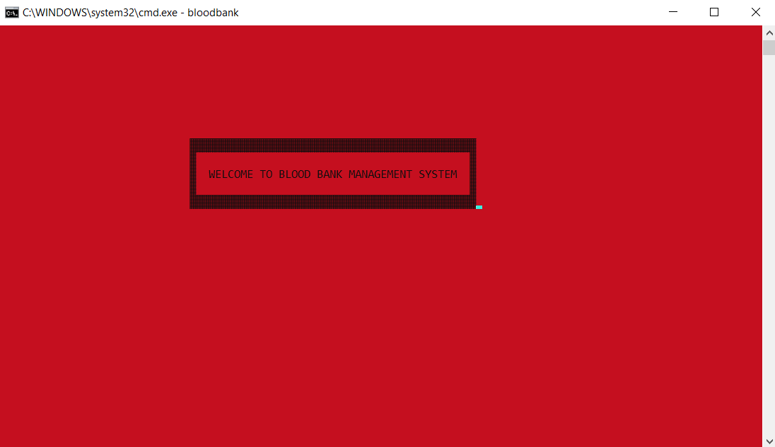
RESULTS:

Slide 6
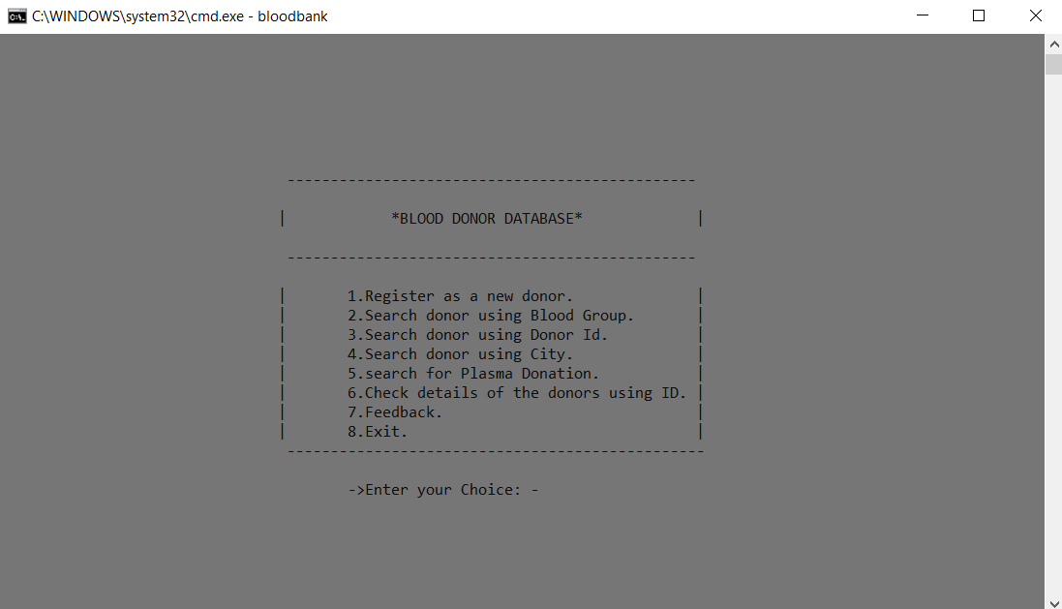

Slide 7
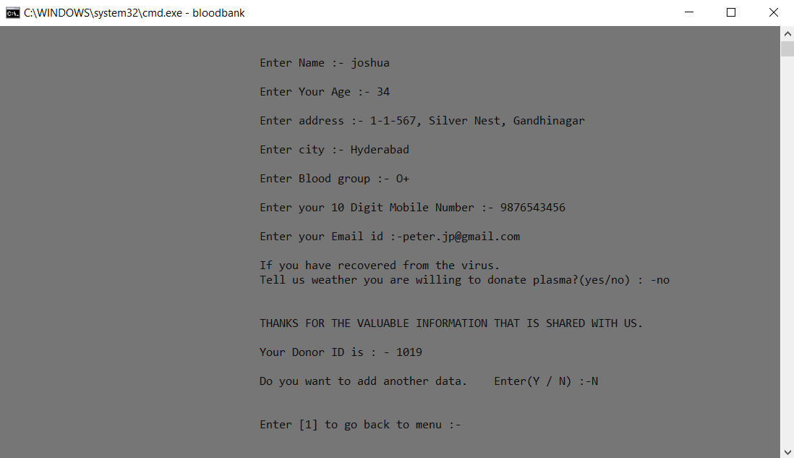

Slide 8
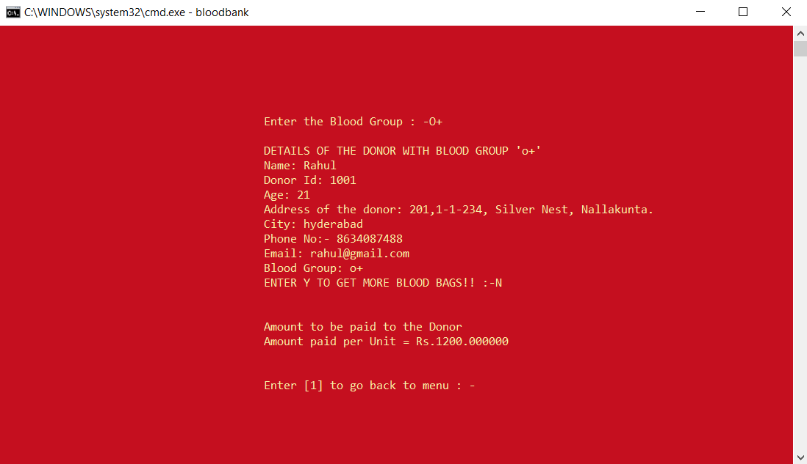

Slide 9
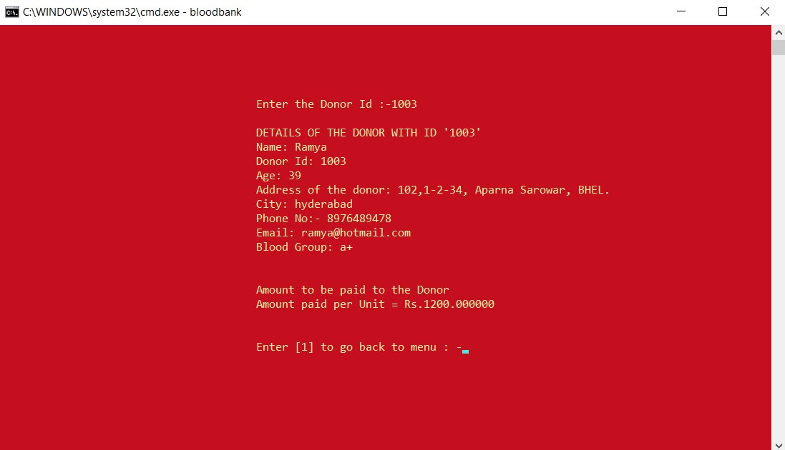

Slide 10
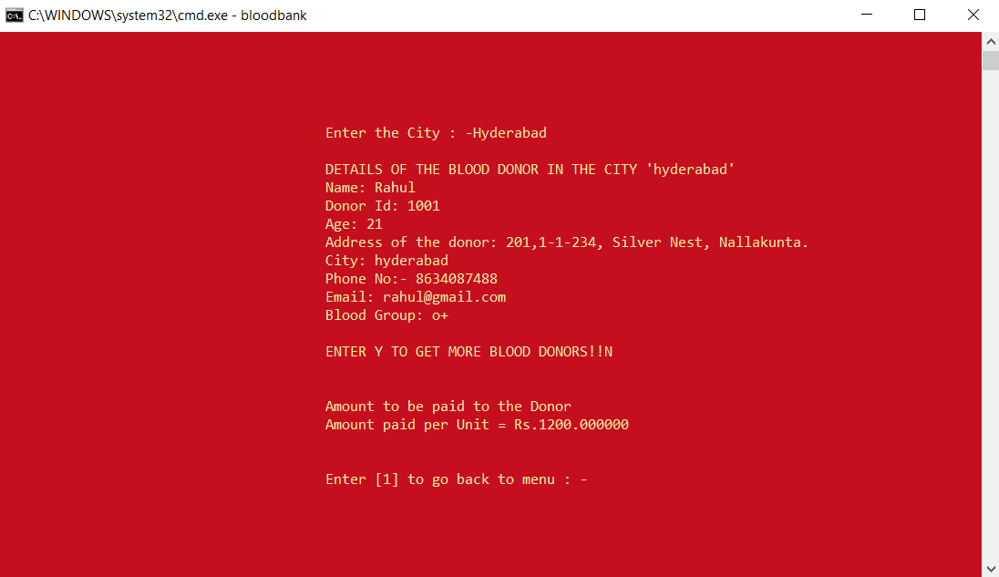

Slide 11
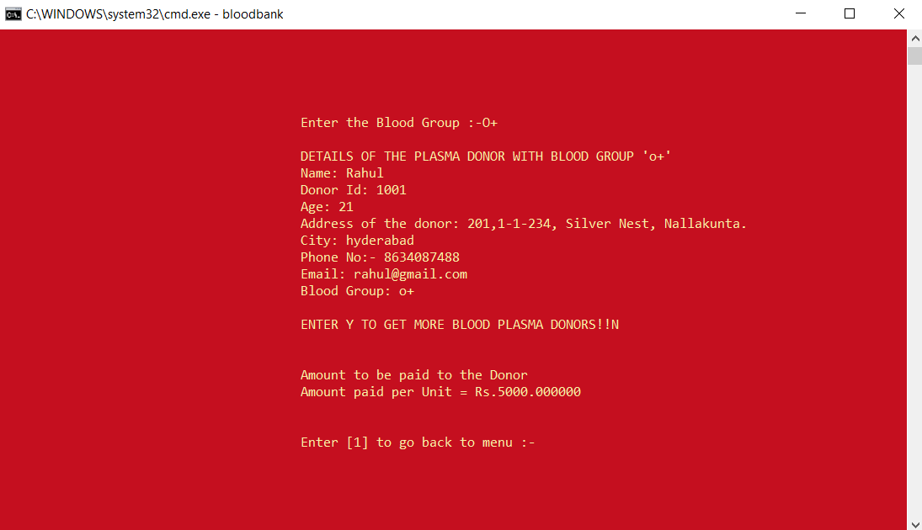

Slide 12
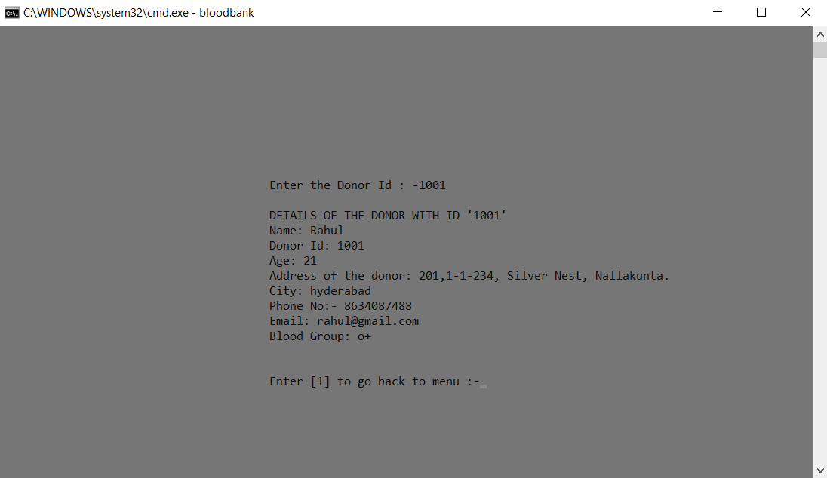

Slide 13
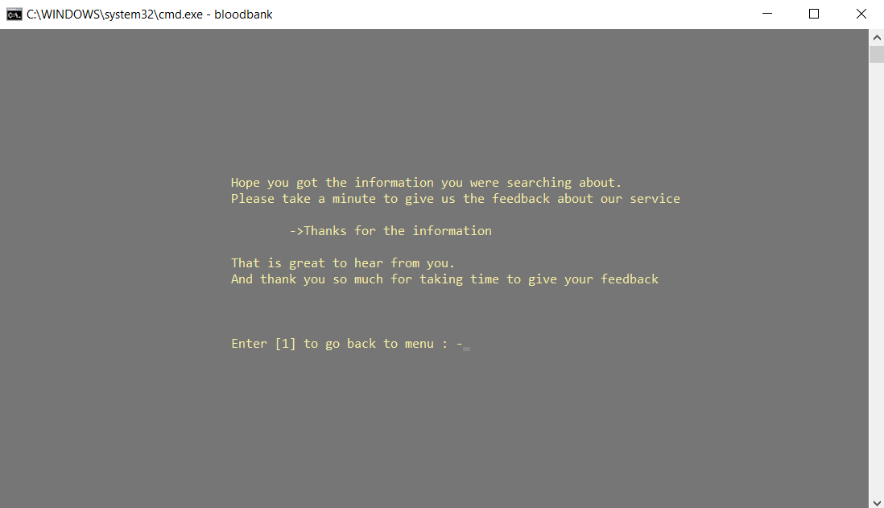

Slide 14
CONCLUSION AND FUTURE WORK:
To conclude, “BLOOD BANK MANAGEMENT SYSTEM” is a console-based C Project which acts as an application to search for the details of the blood donor or plasma donor. The intent behind this project is to provide the information of the donor to the people, who are in need. This app has even more scope now due to the pandemic situation. We need to create more such applications that will be useful for people to do all sorts of tasks from the comfort and safety of their homes.
Our future work includes incorporating more concepts such as Data Structures and DBMS for storing and retrieving the details of the donor. It would help to store the details of the donors in a particular order and retrieving of the data would be easy.
This project can be further improved by converting it into a Mobile Application using Flutter or React Native.

